Slide 1
Military Unit Personnel
A human resources management web app for military establishments

Slide 2
Table of Contents
Purpose
Problem Description
Proposed Solution
Requirements
Functional Requirements
Non-functional Requirements
Implementation
ERD / Use Case
Technologies Used
Future Features

Slide 3
Purpose
Why we need a management system for military personnel

Slide 4
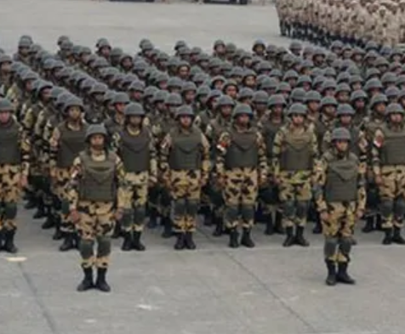
Problem Description
Personnel is the main resource of any military
Several aspects become difficult with greater numbers of personnel:
Presence
Salaries
Detail Tracking
Report Creation
This requires manual labor that can be utilized elsewhere

Slide 5
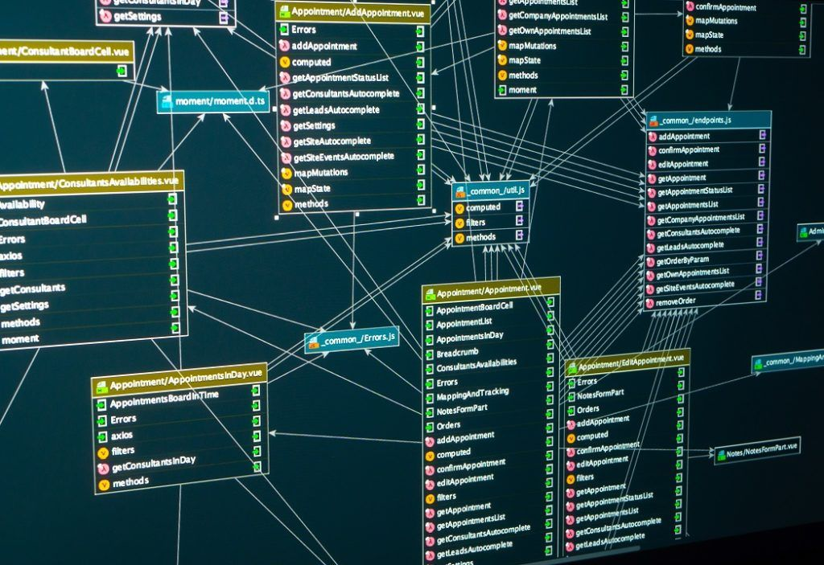
Proposed Solution
A database to keep track of personnel information
A software application to:
Track the presence status
Generate reports
Manipulate personnel information
Automate periodic activities

Slide 6
Requirements
Systemic description of the system required

Slide 7
Functional Requirements
Prototype – For Demonstration Purposes Only
The system must allow recording, accessing and manipulating personnel information (CRUD operations)
The system must accommodate all types of military personnel (two in our case: soldiers and officers)
The system must allow automatic cycling between vacation groups
The system must allow generation of personnel reports

Slide 8
Non-function Requirements
The system must be responsive when accessed from any device (desktop or mobile
The system must be secure, allowing access only to the intended user (admin)
The system must be simplistic in it’s interface; no space for custom queries (to prevent SQL injections
The system must be expect personnel between 100 and 900 personnel per unit.

Slide 9
Implementation
The technical approach for creating the system

Slide 10
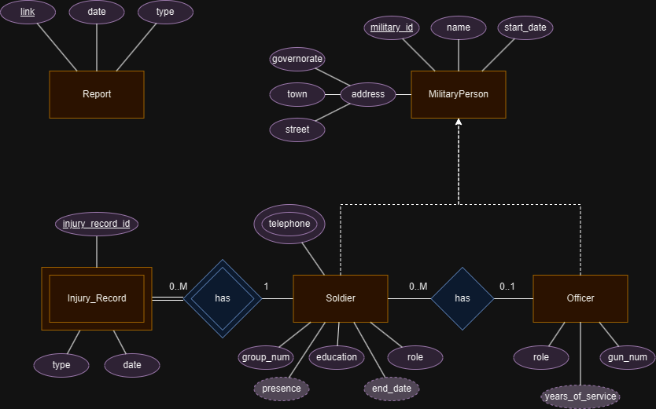
Entity Relationship Diagram

Slide 11
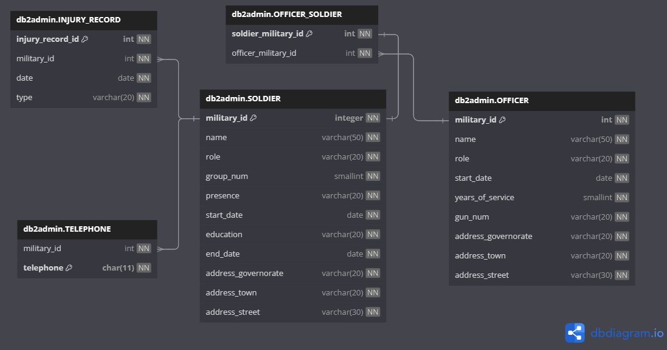
Schema Diagram

Slide 12
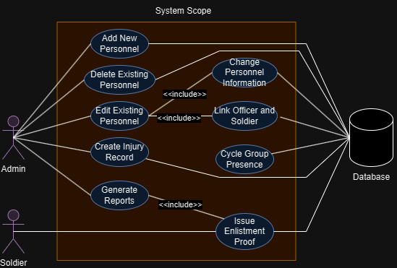
Use Case Diagram

Slide 13
Technologies Used
Presentation Tier
HTML
CSS
JavaScript
Application Tier
Python
Flask
Jinja2
Data Tier
DB2

Slide 14
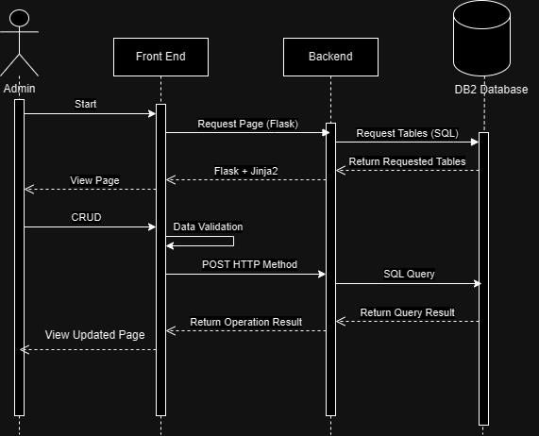
Sequence Diagram General Usage

Slide 15
Future Features
Presence tracking and group vacations
Report generation
Custom sorting
Custom views
Filtering
Manipulation of configuration variables

Slide 16
Thank you!

